Slide 1
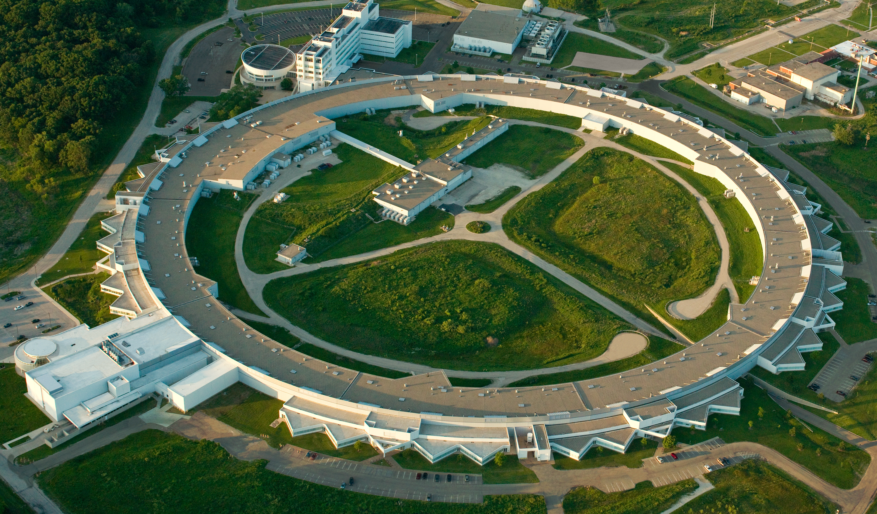
Advanced Photon Source Upgrade Digital LLRF Systems Summary
T. Berenc, M. Borland, J. Calvey, T. Madden, O. Mohsen, A. Nassiri, Y. Yang (ANL)
J. Breeding (Cutting Edge Communications, LLC)

Slide 2
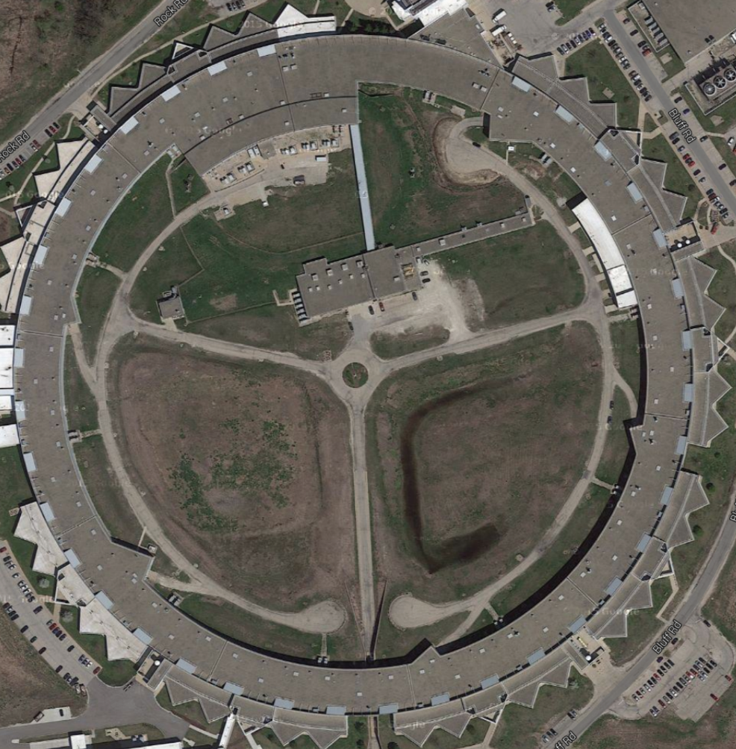
Intent
To share a few LLRF topics and experience that may be of interest, even if not necessarily novel.
Booster
Linac
Outline
PAR
APS-U Storage Ring Systems
Specifications and Simulations
RF Noise Suppression System
Bunch Lengthening Cavity
Injectors
Particle Accumulator Ring
Storage
Ring

Slide 3
APS-U RF Overview
1.1km 6GeV 4th generation synchrotron light source
original 7GeV ring completely dismantled
main RF systems reused with modifications
12 cavities now instead of 16
klystron 60Hz harmonic noise suppression
superconducting Bunch Lengthening cavity
improves lifetime and emittance
Injectors kept intact with some upgrades
increased beam-loading, 2nC → 20nC
digital LLRF in Particle Accumulator Ring
new ring-to-ring Timing & Synchronization^{[1,2]}
Booster
Linac
PAR
Storage
Ring
[1] U. Wienands et. al. IPAC 2018, MEPAF007
[2] U. Wienands et. al., LLRF 2024 Topical Workshop

Slide 4
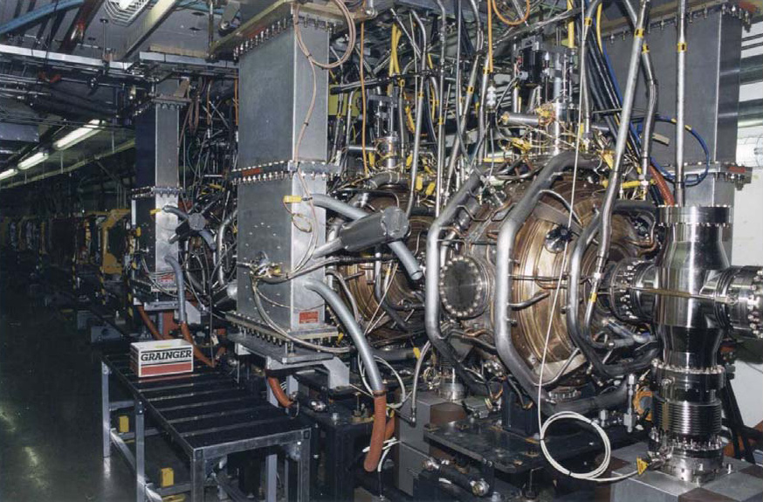
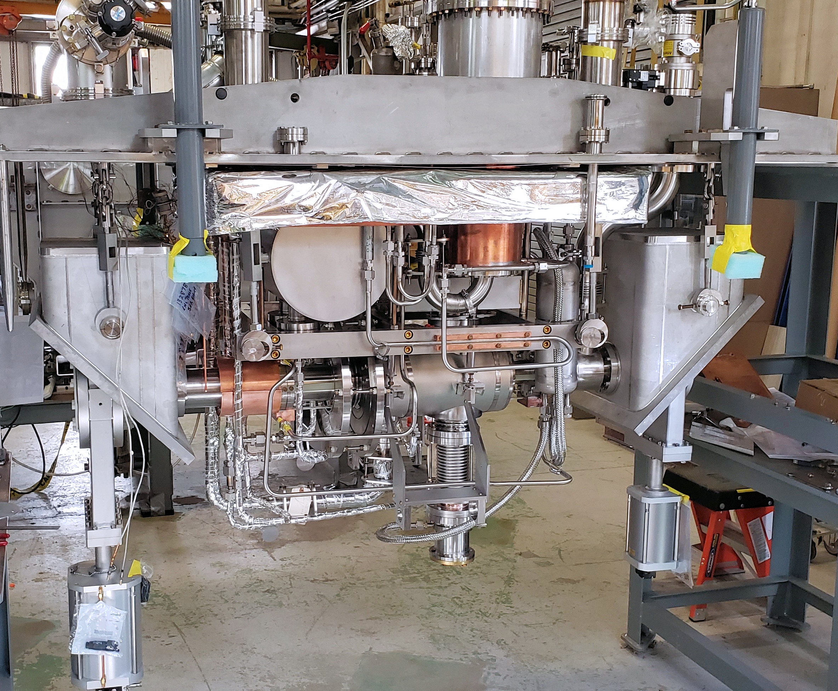
Storage Ring - Specifications
Minimize re-design of existing main (352MHz, h=1296) RF systems
new 4th harmonic (1408MHz) passive superconducting Bunch Lengthening System (BLS)
QL = ~7e6, (R/Q)a = 104 Ohm, BW3dB = ~ 200 Hz, single-cavity V=~1MV
detuning (~ +10kHz) contributes to growth of longitudinal oscillations
Main RF System (352MHz)
Bunch Lengthening Cavity
(Mike Kelly, et. al.)
[3] M. Kelly et. al. IPAC 2024, MEPS10
[4] J. Fuerst et. al., MEDSI 2025, WEOC04
4

Slide 5
Storage Ring - Specifications
Beam Stability Specifications
beam orbit stability
horizontal: 1.25µm, 0.25µrad
vertical: 0.4µm, 0.17µrad
beam energy noise: <1.3e-4 (10% of energy spread)
RF Specifications were guided by existing performance → required improvements
Are the existing noise levels tolerable?
with regards to beam stability
with regards to effects on longitudinal feedback system
Is the beam-cavity interaction stable under new conditions?
including the bunch lengthening cavity
[5] APS-U Functional Requirements Document (FReD)
5

Slide 6
Storage Ring - Specifications
Are the existing noise levels tolerable?
Is the beam-cavity interaction stable under new conditions?
Collaborate with Physicists early in the system design process
developed a model for RF feedback to include in elegant^{[6-7]} particle tracking simulations ^{[8]}
included ability to inject noise
RF system time-domain noise measurements used in simulations
no surprise: our 1MW klystrons are the dominant source of RF noise
for stability specs: factor of 3 improvement → 0.075% rms, 0.1deg rms [1kHz BW]
to prevent longitudinal feedback system saturation: goal of factor of 10 improvement
[6] M. Borland, ANL/APS LS-287 (2000) latest at v2025.2
[7] https://ops.aps.anl.gov/manuals/elegant_latest/elegant.pdf
[8] T. Berenc, M.Borland, IPAC2015, MOPMA006
6

Slide 7
Storage Ring - Simulations
RF feedback integrated into elegant RFMODE element
feedback in amp/phase or I/Q, individual custom filters
parametric and additive noise for generator and receiver
can model feed-forward using generator I/Q noise inputs
[9] Berenc et. al. - LLRF 2017
7

Slide 8
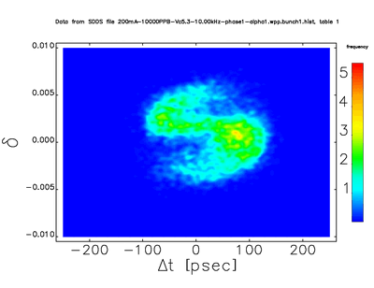
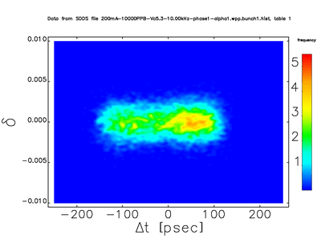
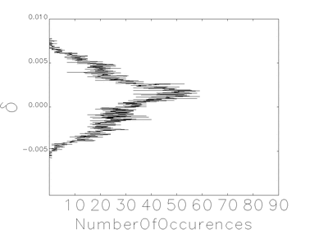
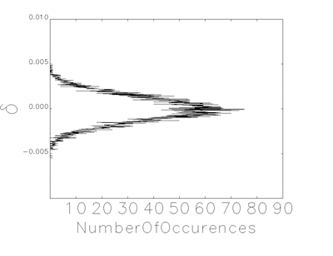
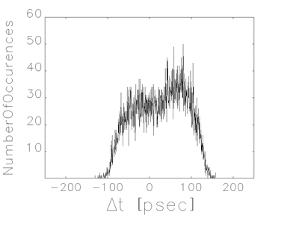
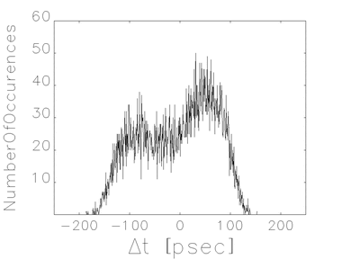
RFNS OFF vs. RFNS ON
Simulations
10,000 particles per bunch,
216 bunches (2.16M particles)
100,000 turns
~6 hours on 128 cores (AMD EPYC 7713 64C 2GHz processors)
We gratefully acknowledge the computing resources provided on Improv, a high-performance computing cluster operated by the Laboratory Computing Resource Center at Argonne National Laboratory.

Slide 9
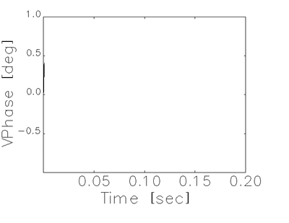
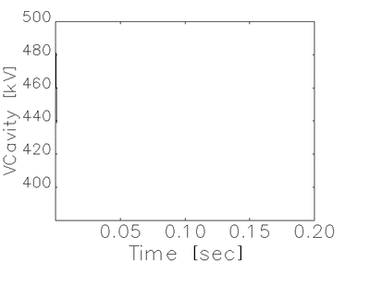
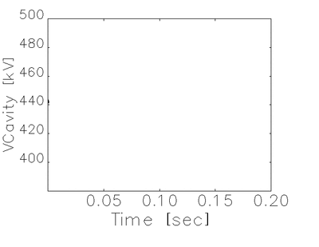

RFNS OFF vs. RFNS ON
Simulations

Slide 10
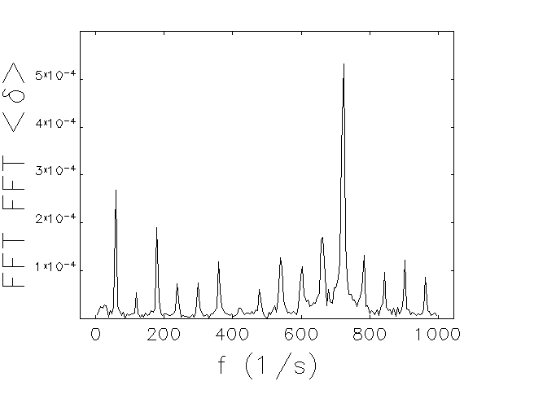
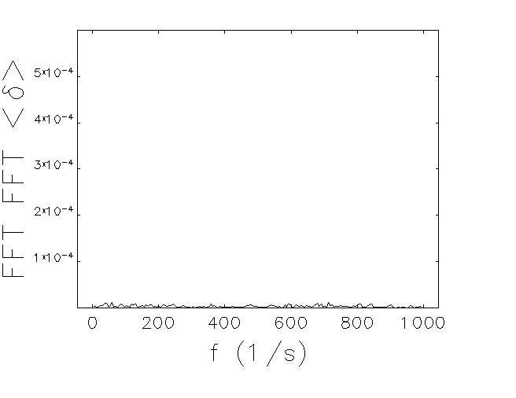
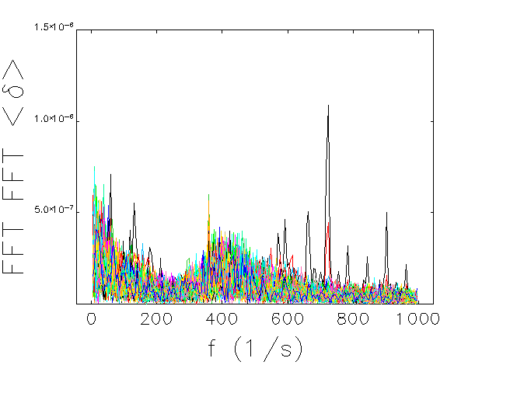
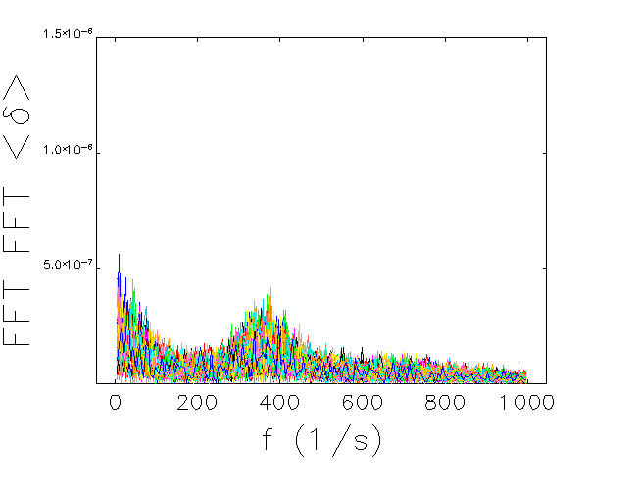
Simulations – Longitudinal Coupled Bunch Modes
RFNS OFF vs. RFNS ON
We learned:
for a Passive Bunch Lengthening Cavity
Mode0 synchrotron tune is still dictated by the Main RF voltage
Robinson instability still dictated by Main RF conditions (i.e., generator)
Higher order coupled bunch modes see a synchrotron tune shift from the flattened potential well created by the Mode0 induced voltage
Mode 0
Mode 0
Modes 1-107
Modes 1-107
[10] R. Lindberg, M. Borland, private communication

Slide 11
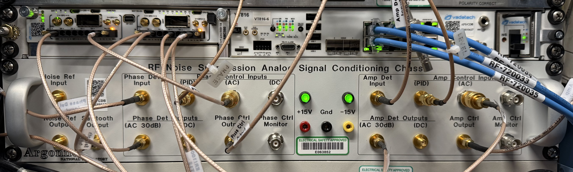
RF Noise Suppression – targeted 60Hz harmonics
Some constraints
existing systems are purely analog-based
the way the 1MW klystron-based systems are regulated
fixed RF drive (saturation), global amp. control is limited, ~100Hz BW mod-anode feedback
phase loops straight forward: inner loop around klystron, outer-loop around cavities
Approach: minimize RF noise at the source, don’t let it get into the cavities in the first place
11
[11] T. Berenc et. al., LLRF 2024 Topical Workshop

Slide 12
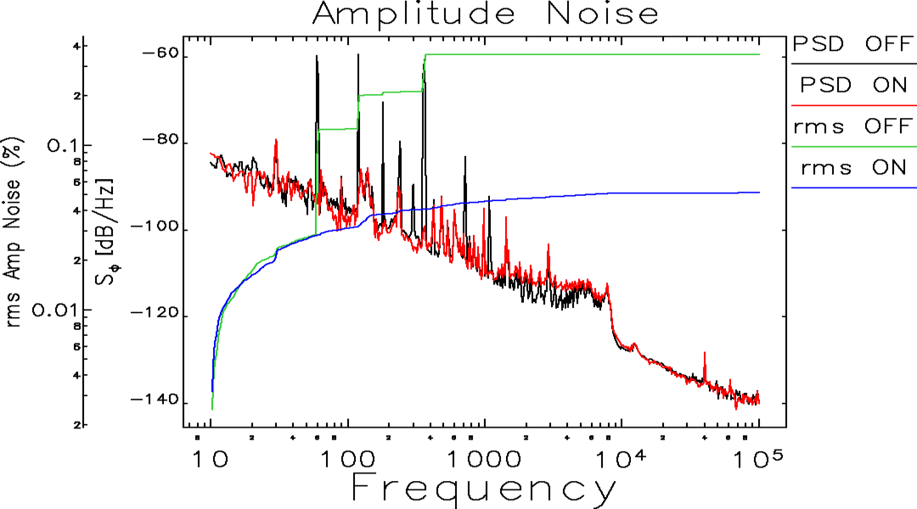
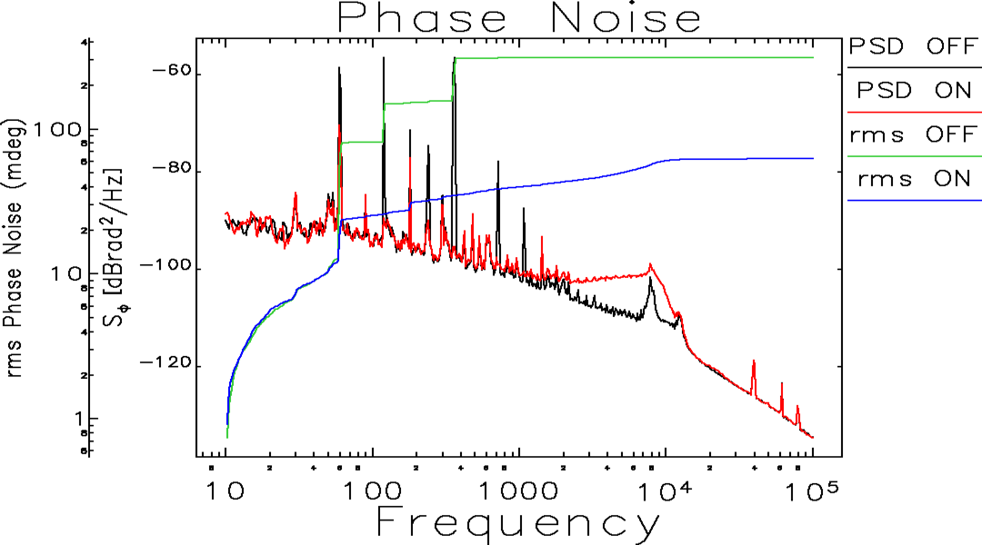
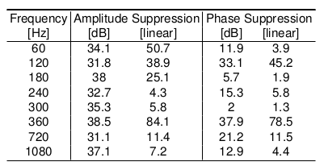
RF Noise Suppression – some results
Specifications
0.075% rms, 0.1deg rms [1kHz BW]
future RFNS improvements
presently adding harmonics
will explore wideband changes

Slide 13
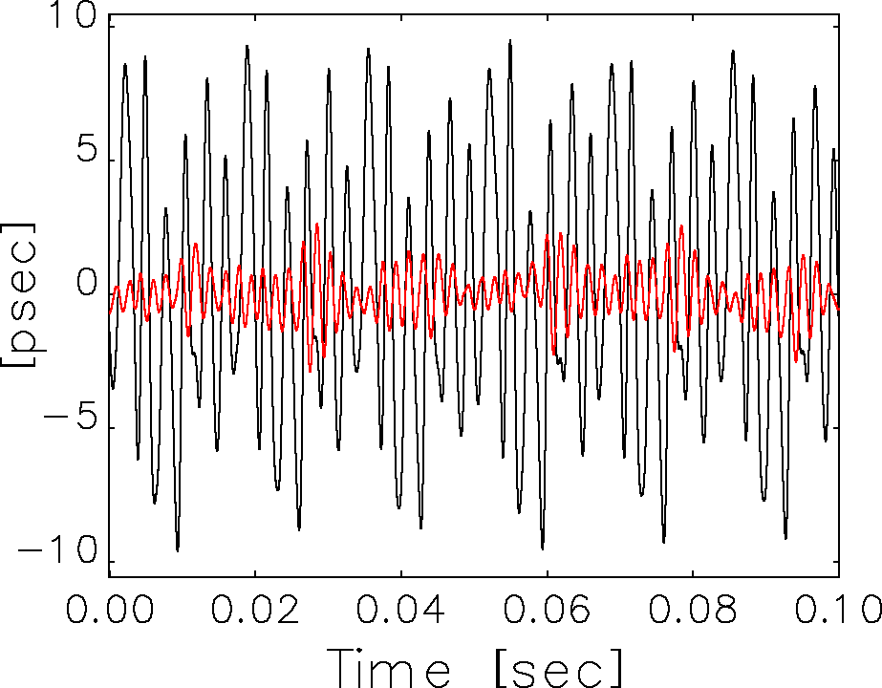
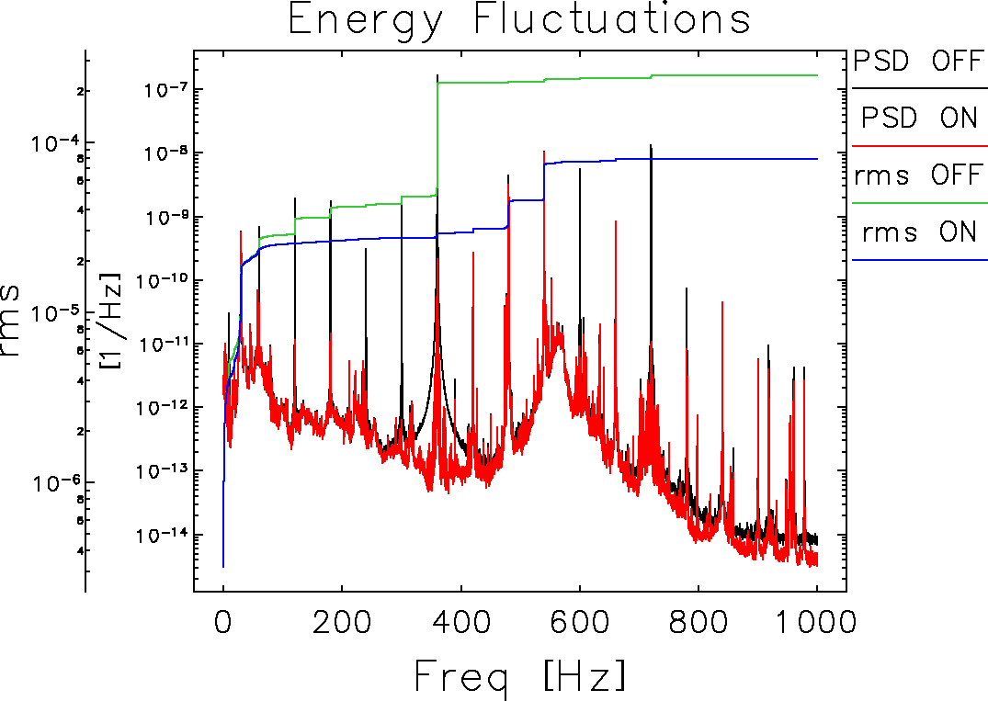
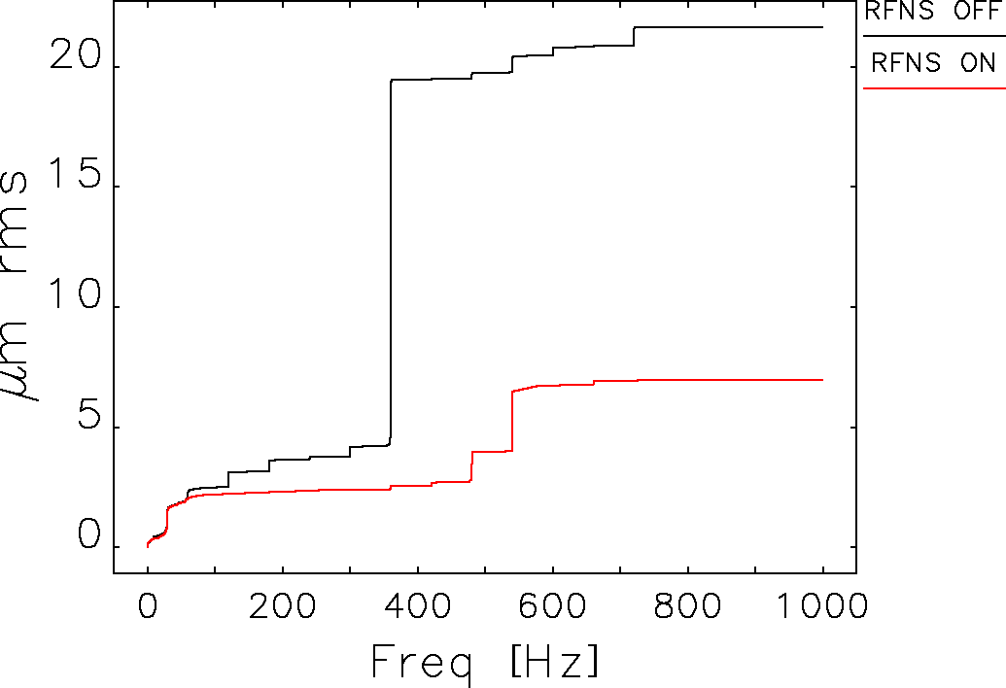
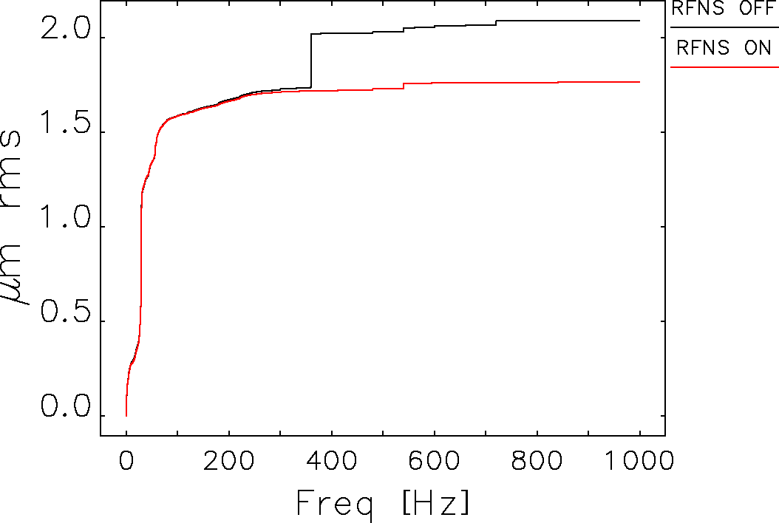
RF Noise Suppression – some results
Beam Jitter
energy noise spec: <1.3e-4
beam orbit stability spec
horizontal: 1.25µm, 0.25µrad
vertical: 0.4µm, 0.17µrad
Girders have a 30Hz vibration that is being addressed.
measured vertical: ~1um
future RFNS improvements
presently adding harmonics
will explore wideband changes
horizontal rms motion
at dispersive P3 BPMs
Solid State in the future
Klystrons will be replaced with Solid-State Amplifiers. Phase noise is nearly 20dB less over 1kHz bandwidth
horizontal rms motion
near IDs (P0 BPMs)

Slide 14
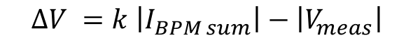
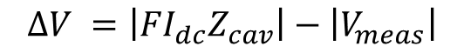
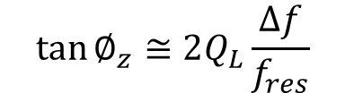
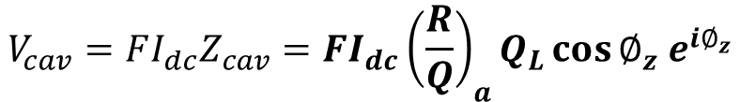
Bunch Lengthening System
Bunch Lengthening Cavity is a passive cavity (i.e., purely beam-driven)
Positive detuning (i.e., f_{res} > f_{rf}), beam drives cavity at nearly +90deg impedance angle
$$V_{cav}=FI_{dc}Z_{cav}=FI_{dc}{\left(\frac{R}{Q}\right)}_{a}Q_{L}\cos{∅_{z} e^{i∅_{z}}}$$
$$\tan{∅_{z}}≅2Q_{L}\frac{∆f}{f_{res}}$$
Q_{L} and ∆f adjust both the magnitude and phase of V_{cav}
We have adjustable couplers, but we do not adjust them
∆f is adjusted via a pneumatic tuner
we regulate the tuner pressure
tuning is held fixed to achieve desired V_{cav} at operational beam current
Quench detection is simply based upon the difference between expected and actual |V_{cav}|
$$∆V =\left|{FI}_{dc}Z_{cav}\right|−\left|V_{meas}\right|$$
use BPM sum signal and field probe, assume steady-state
scaling factor k represents impedance magnitude
works for all beam currents (i.e., when filling the ring)
also detects over-voltage (e.g., mis-tuning)
$$∆V =k \left|I_{BPM sum}\right|−\left|V_{meas}\right|$$

Slide 15
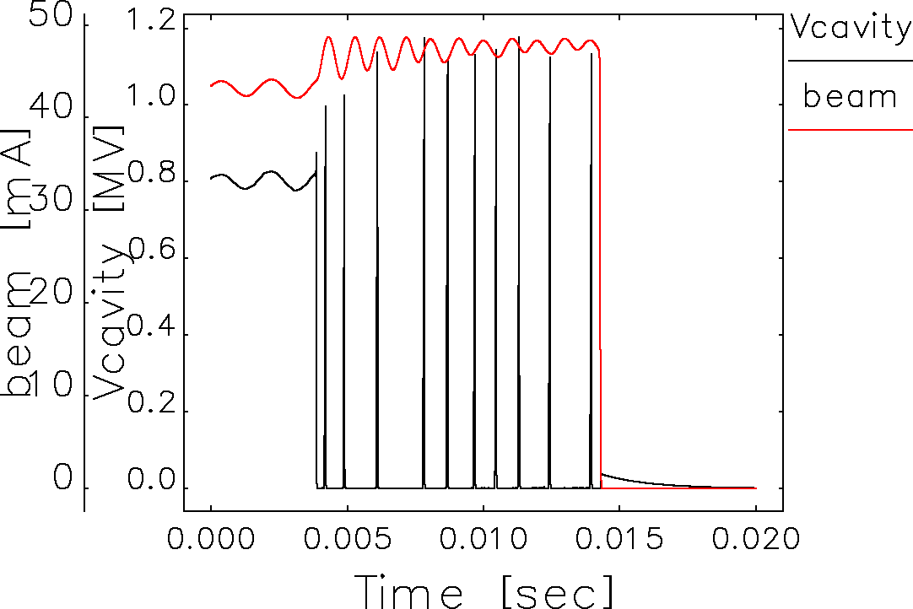
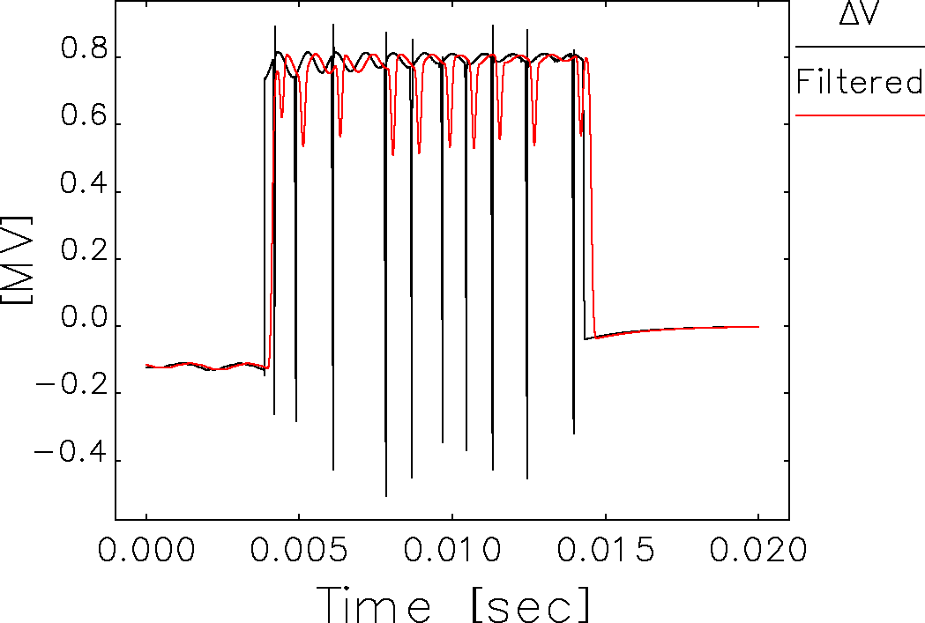
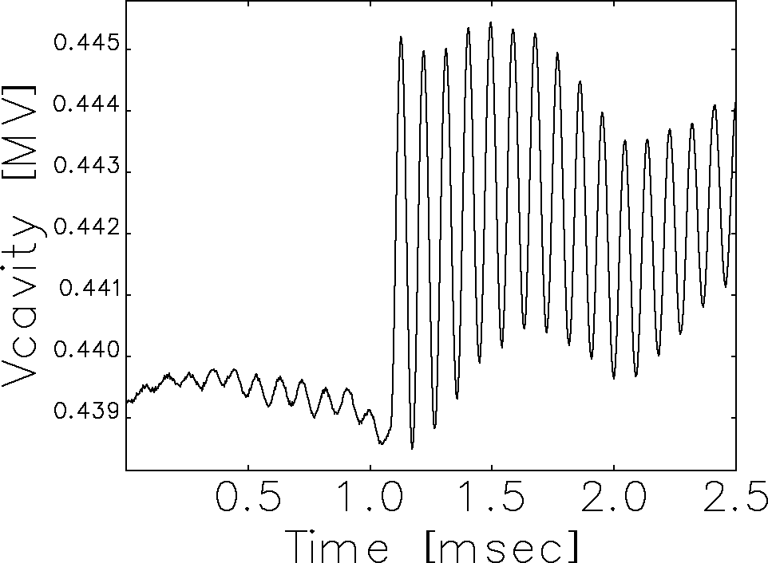
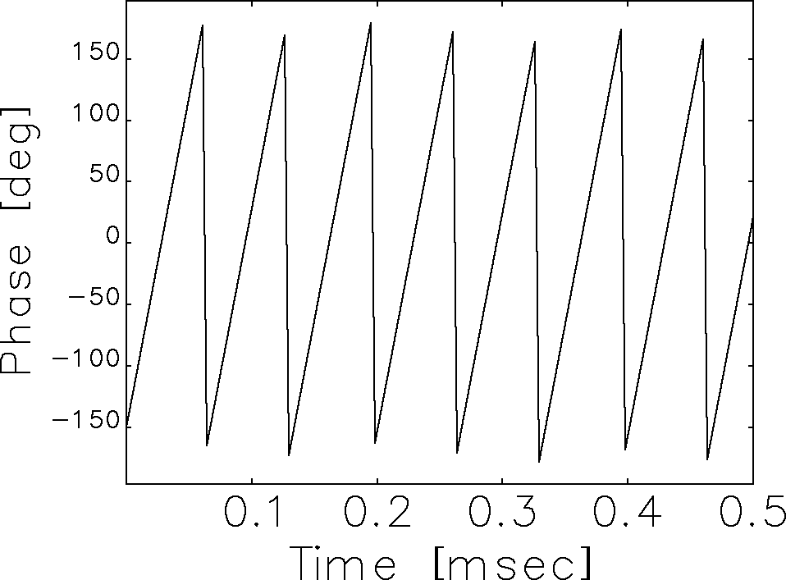
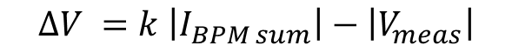
Bunch Lengthening System - Quench
Cavity Voltage and Beam
Quench during BLS commissioning
Passive cavity
have to use beam for conditioning
cavity protection must dump beam
Quench detect circuit
uses low-pass filter on
this prevents spurious trips (e.g., during swap-out)
includes adjustable delay to allow multiple breakdowns before dumping beam
Detuning, ∆f, can be determined by looking at magnitude oscillations at beam injections, or dø/dt at beam dump
$$∆V =k \left|I_{BPM sum}\right|−\left|V_{meas}\right|$$
Quench Detect ∆V
|Vcav| ringing @injection
ø Rotation during dump

Slide 16
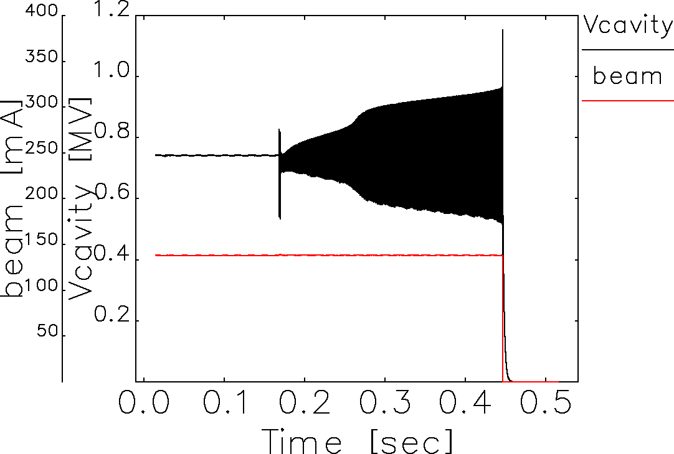
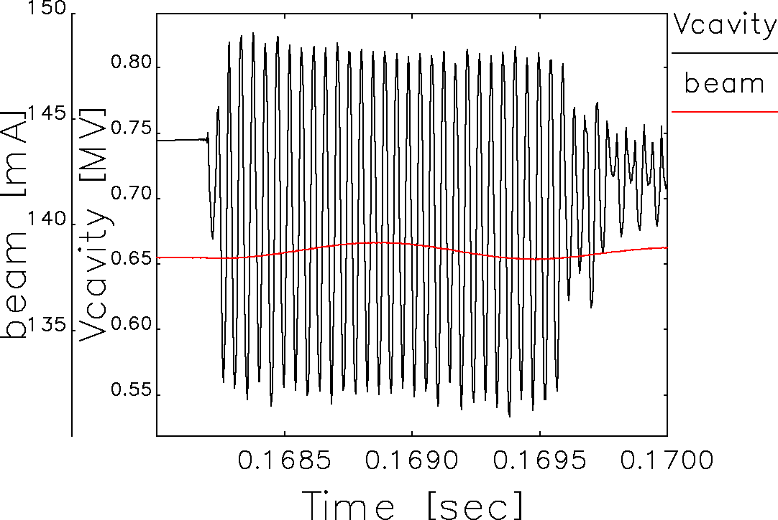
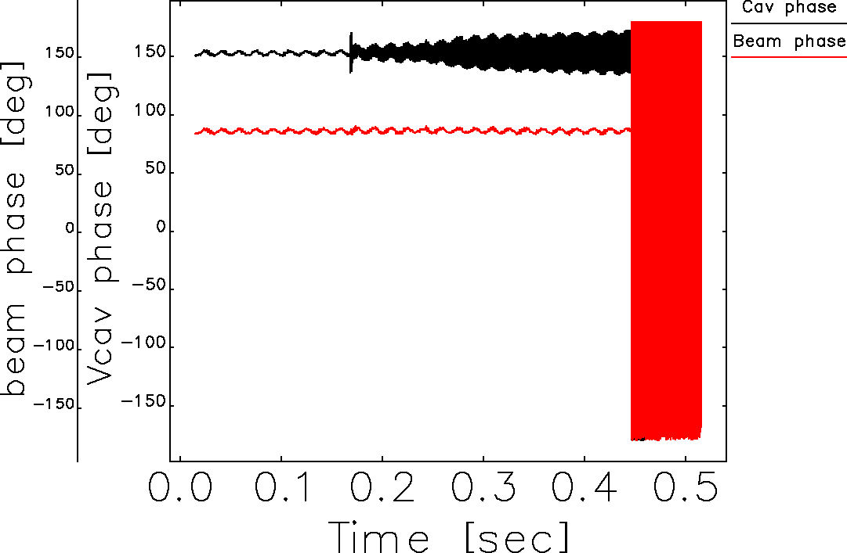
Bunch Lengthening System
Recent Event not yet understood
Cavity Voltage and Beam
Zoom: Vcav and Beam
Phase
Turning back on after maintenance shutdown
sudden initial transient followed by oscillatory response
bump in Helium pressure was seen
Oscillations at ∆f , similar response to stepped drive
Beam rides through it, can’t respond at ∆f = ~20kHz
beam is nearly a perfect current source
not a generator which becomes mismatched
Is this multipacting driven with an ideal current source?

Slide 17
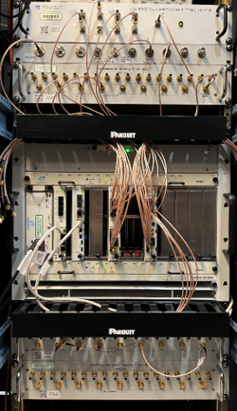
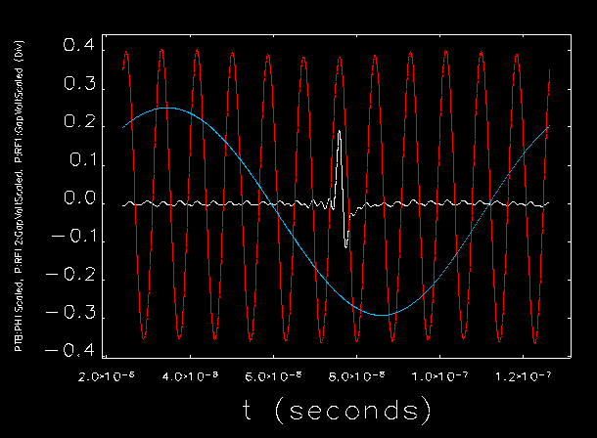
Particle Accumulator Ring
digital LLRF started with these systems.
successful collaboration with SNS and John E. Breeding
tight integration w/ Data Acquisition ^{[12]}
same codebase used for BLS, RFNS
Fundamental & Harmonic in Operations
Ferrite tuners on both
Harmonic used for bunch compression
Extensive effort for transfer to operations
spreadsheets of all PVs + fields
alarm levels, and alarm handlers
Turn-on and alarm response instructions
PAR 9.78 MHz (h=1)
[12] T. Madden, Wednesday poster session
PAR 117 MHz (h=12)

Slide 18
Future Directions
RFNS – additional 60Hz harmonics
PAR – fast voltage modulations for beam manipulations
Booster – digital LLRF and transient beam-loading compensation
Storage Ring – LLRF for Solid-State Systems
Linac Photo-Cathode Drive Laser – timing & synchronization
Thanks for Listening

